Slide 1
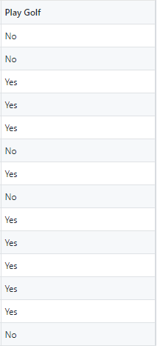



Target Variable:
Entropy Formula:
Target Samples:
Finding Entropy of System:

Slide 2
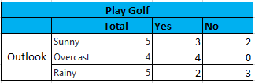

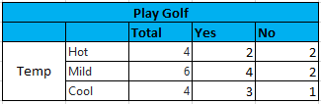






Slide 3





Information Gain Formula:

Slide 4
Outlook | Temp | Humidity | Windy | Play Golf
Overcast | Hot | High | FALSE | Yes
Overcast | Cool | Normal | TRUE | Yes
Overcast | Mild | High | TRUE | Yes
Overcast | Hot | Normal | FALSE | Yes
Group – 1
Rainy | Hot | High | FALSE | No
Rainy | Hot | High | TRUE | No
Rainy | Mild | High | FALSE | No
Rainy | Cool | Normal | FALSE | Yes
Rainy | Mild | Normal | TRUE | Yes
Group – 2
Sunny | Mild | High | FALSE | Yes
Sunny | Cool | Normal | FALSE | Yes
Sunny | Cool | Normal | TRUE | No
Sunny | Mild | Normal | FALSE | Yes
Sunny | Mild | High | TRUE | No
Group – 3

Slide 5
Outlook
Root Node
Sub-Partition
Sunny
Overcast
Rainy
Yes
Windy
Humidity
FALSE
TRUE
High
Normal
Yes
No
No
Yes
Leaf Node

